Slide 1
Physics for Scientists and Engineers
Paul A. Tipler • Gene Mosca
Fifth Edition
Chapter 35:
Applications of the
Schrödinger Equation
Copyright © 2004 by W. H. Freeman & Company

Slide 2
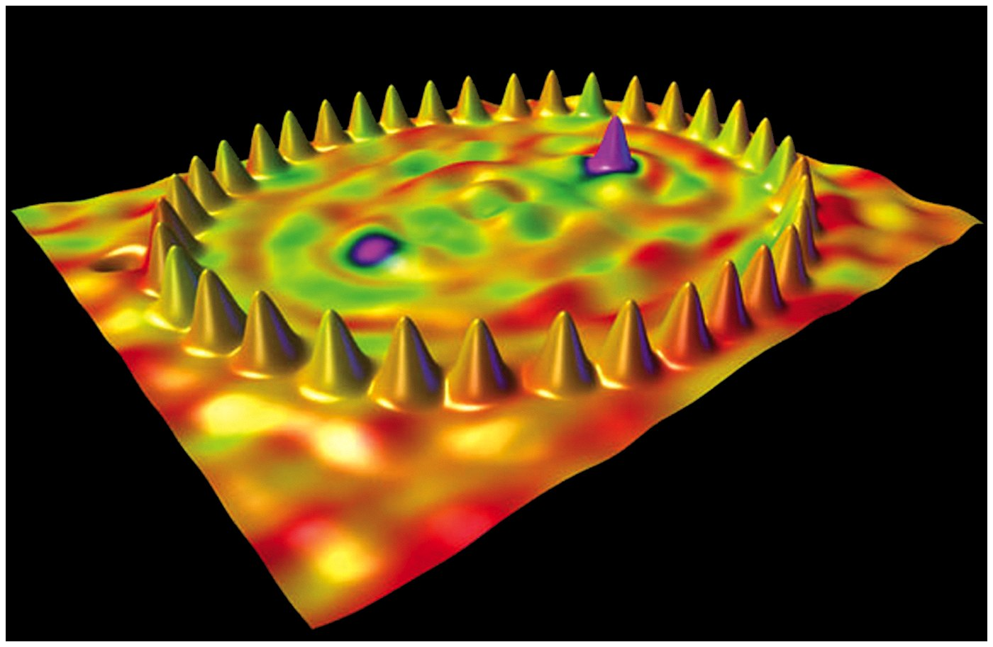

Slide 3
35-1
The Schrödinger Equation

Slide 4


Slide 5


Slide 6
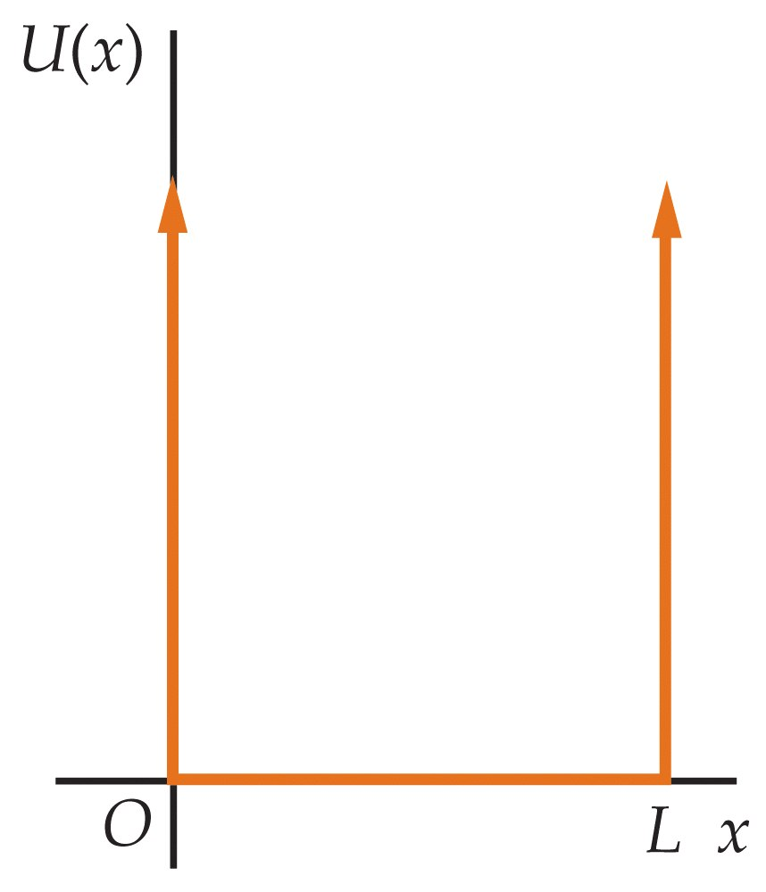

Slide 7
35-2
A Particle in a Finite Square Well

Slide 8
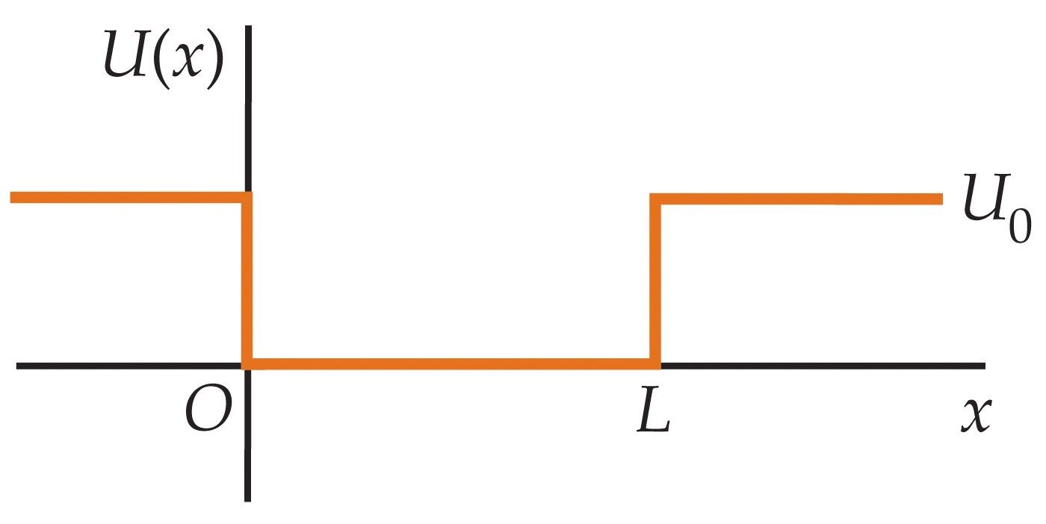

Slide 9
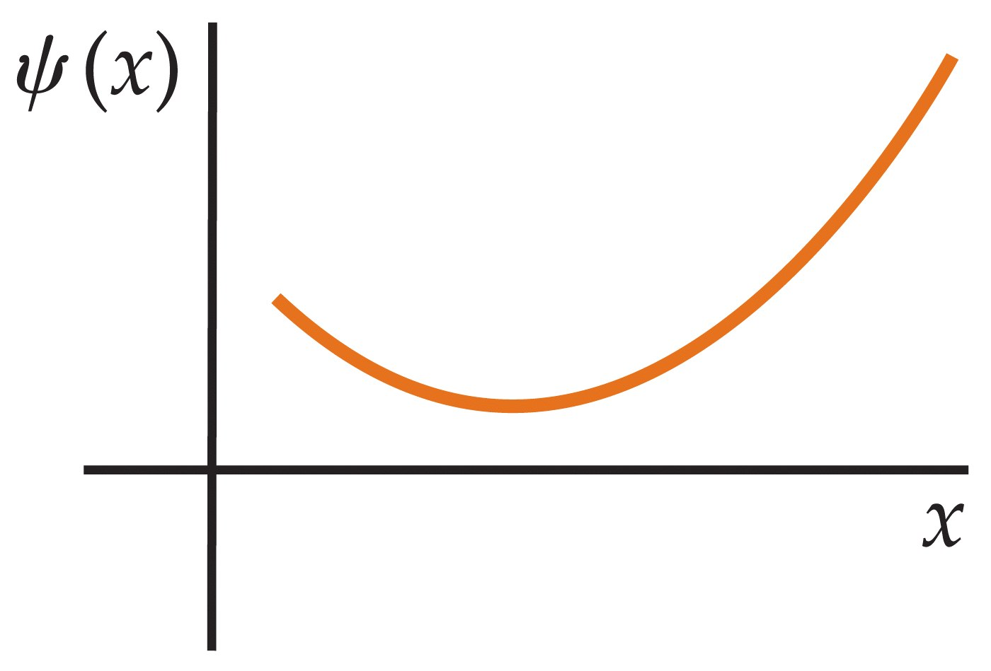

Slide 10
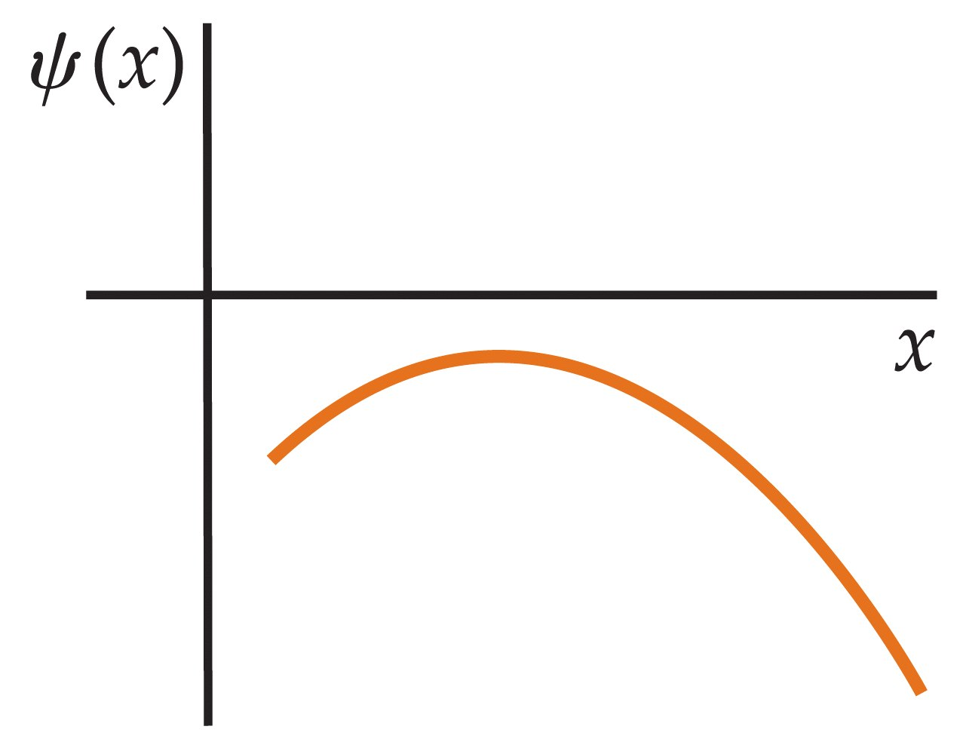

Slide 11
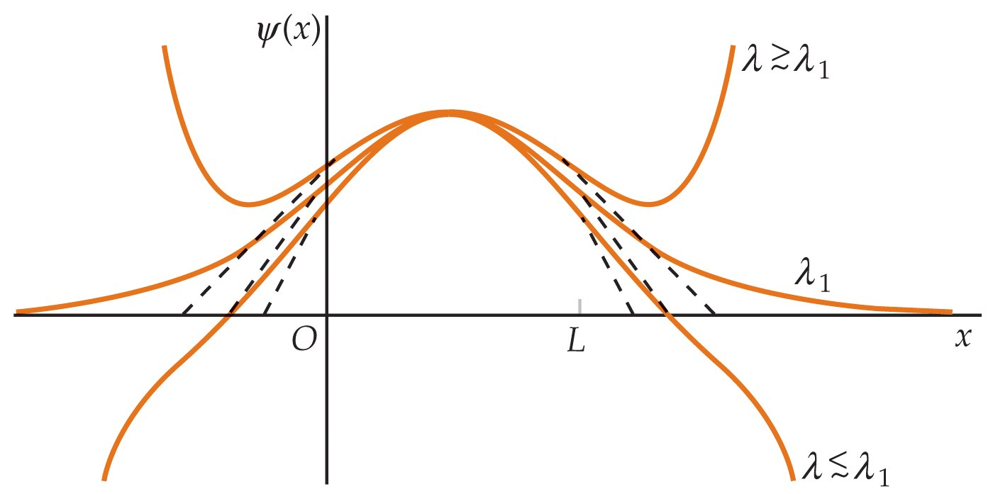

Slide 12
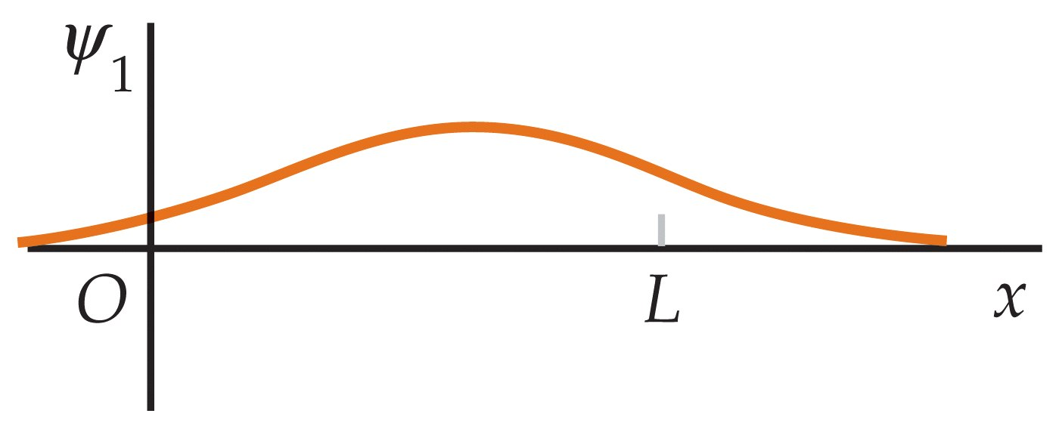

Slide 13
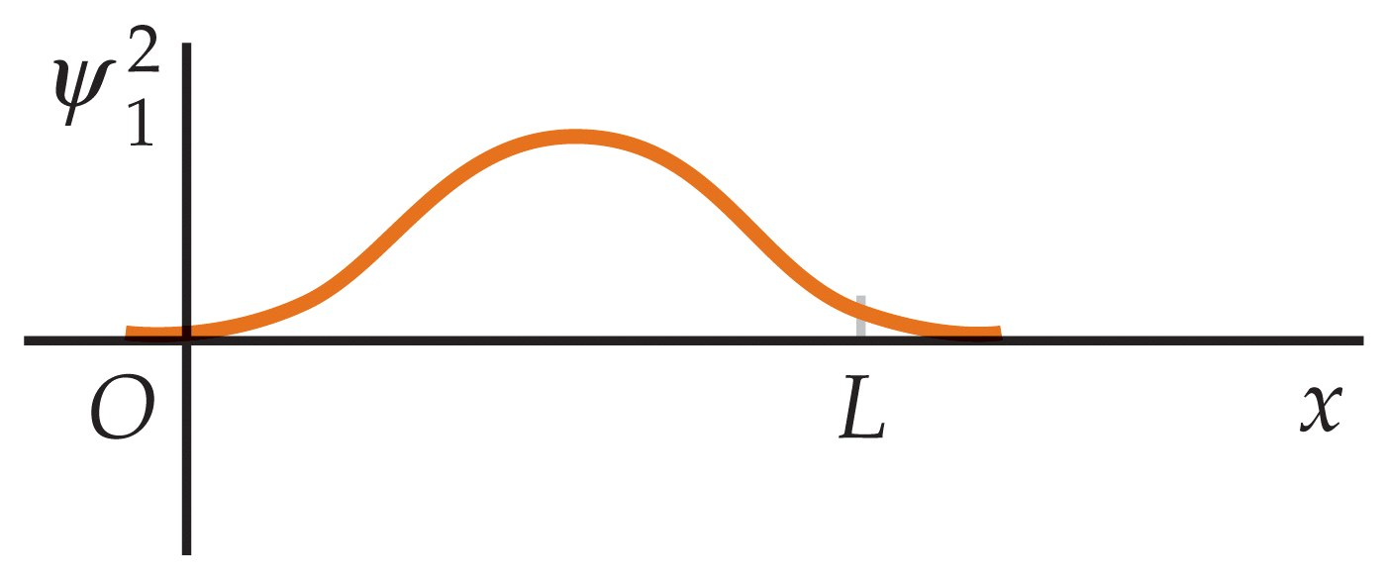

Slide 14
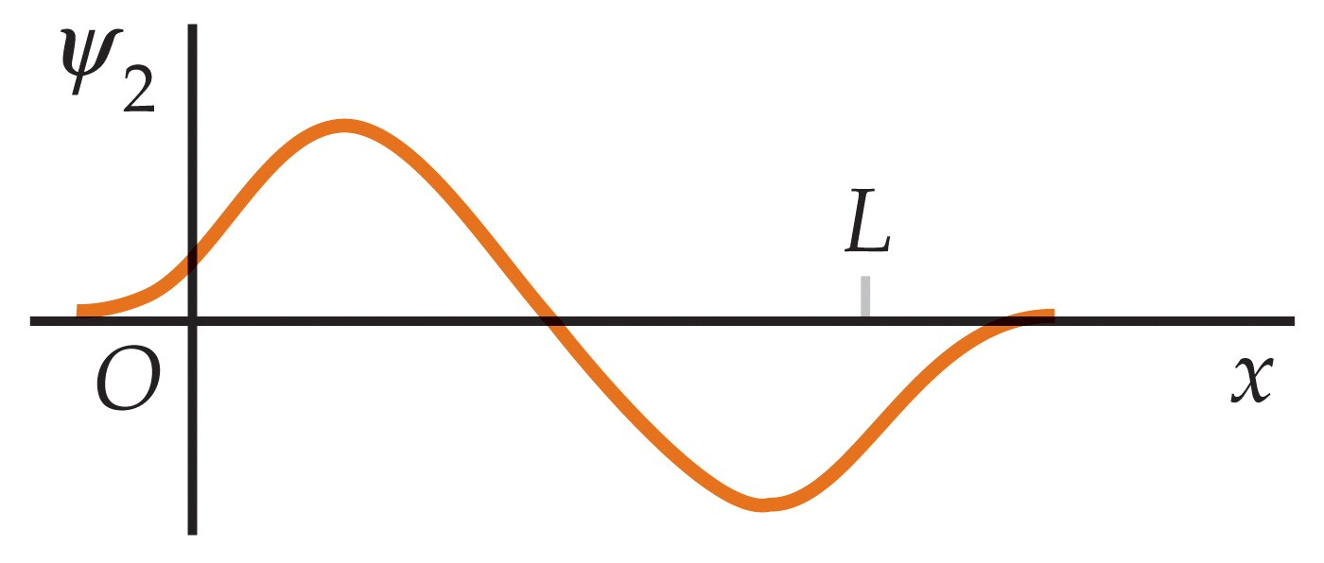

Slide 15
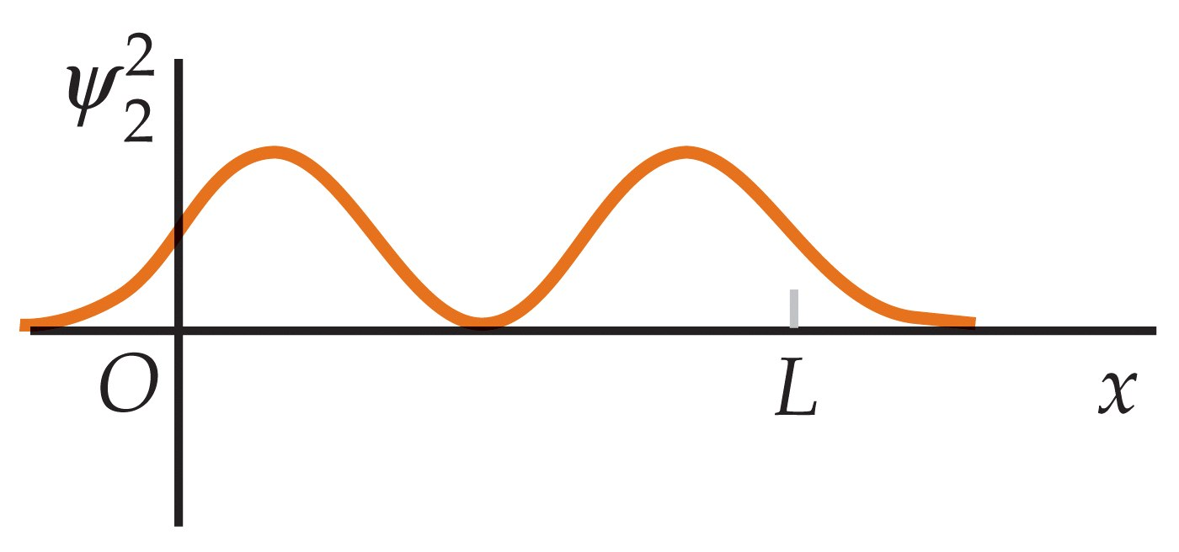

Slide 16
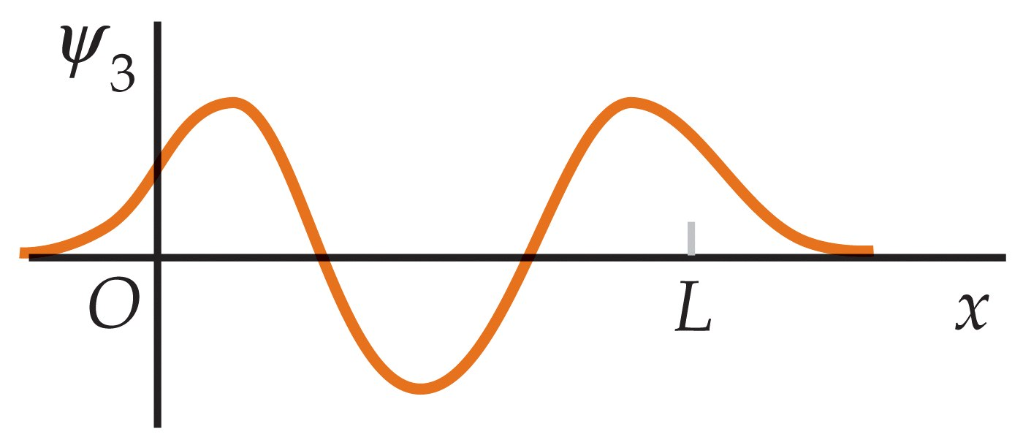

Slide 17
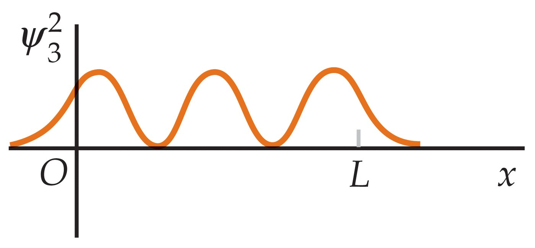

Slide 18
35-3
The Harmonic Oscillator

Slide 19
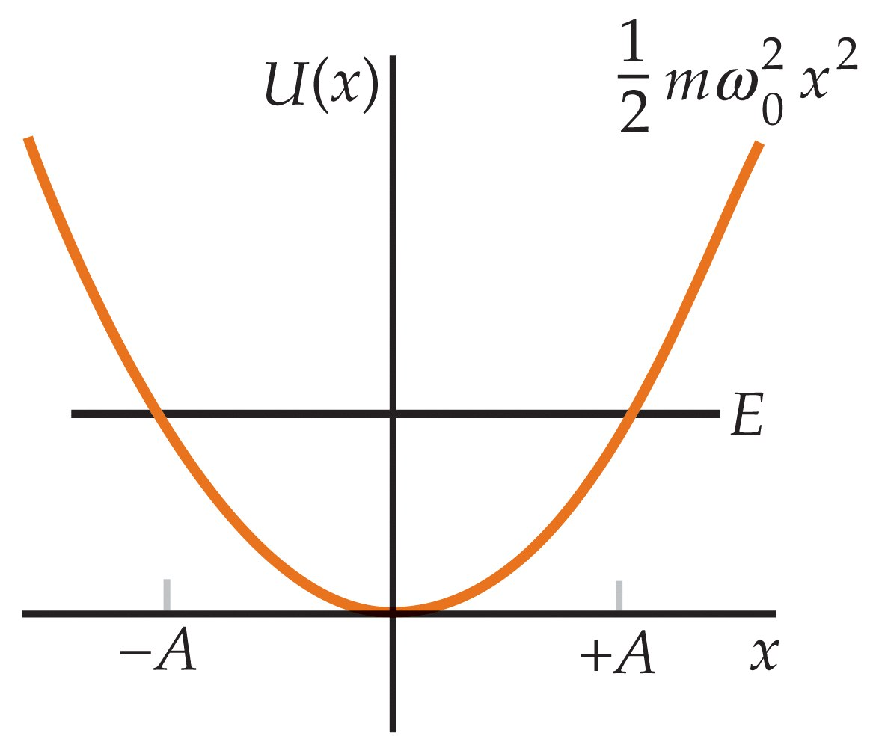

Slide 20
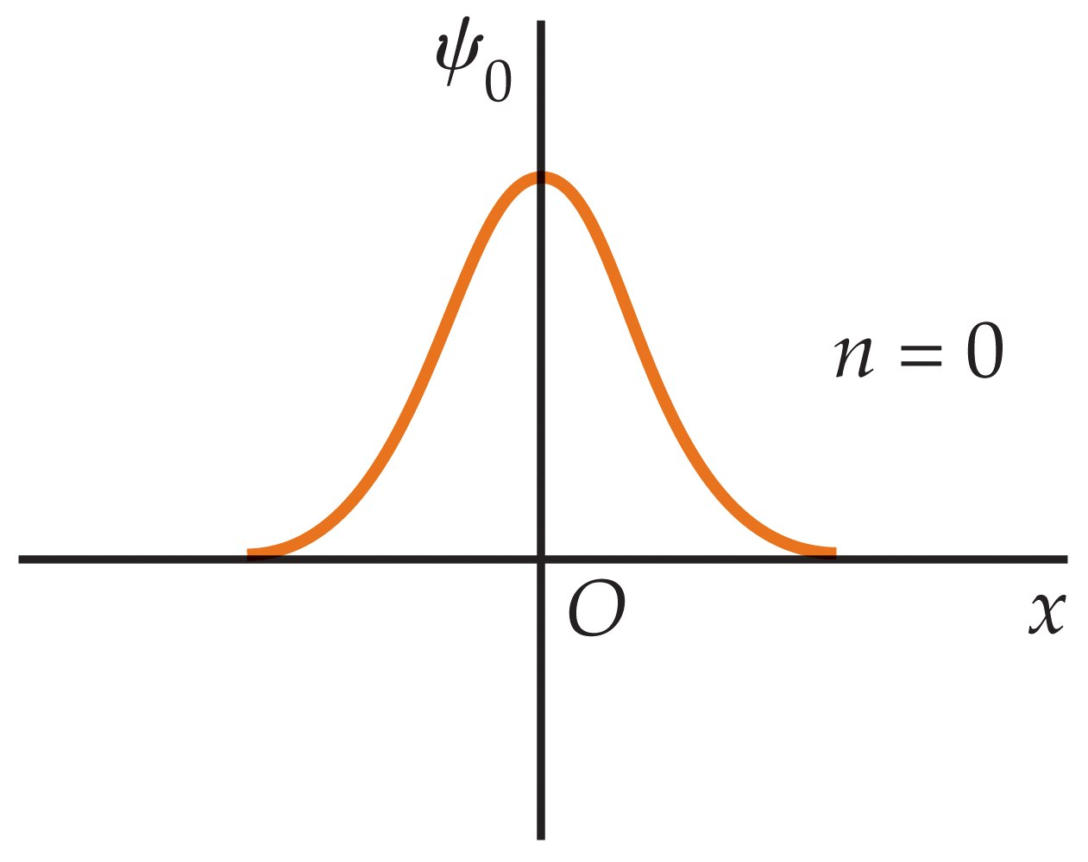

Slide 21
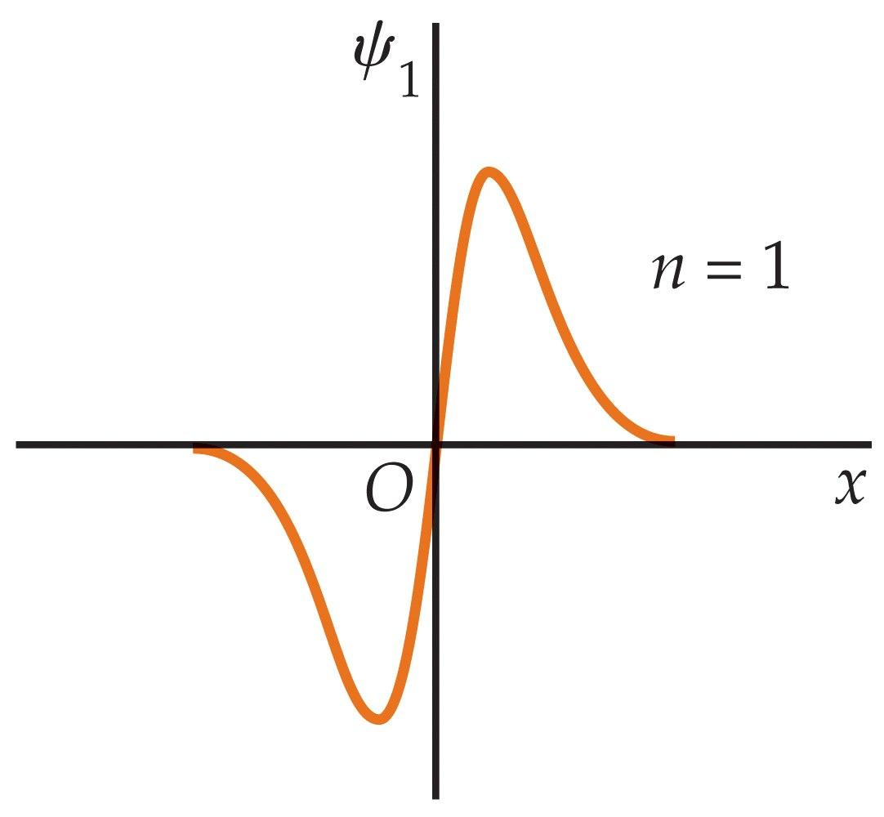

Slide 22
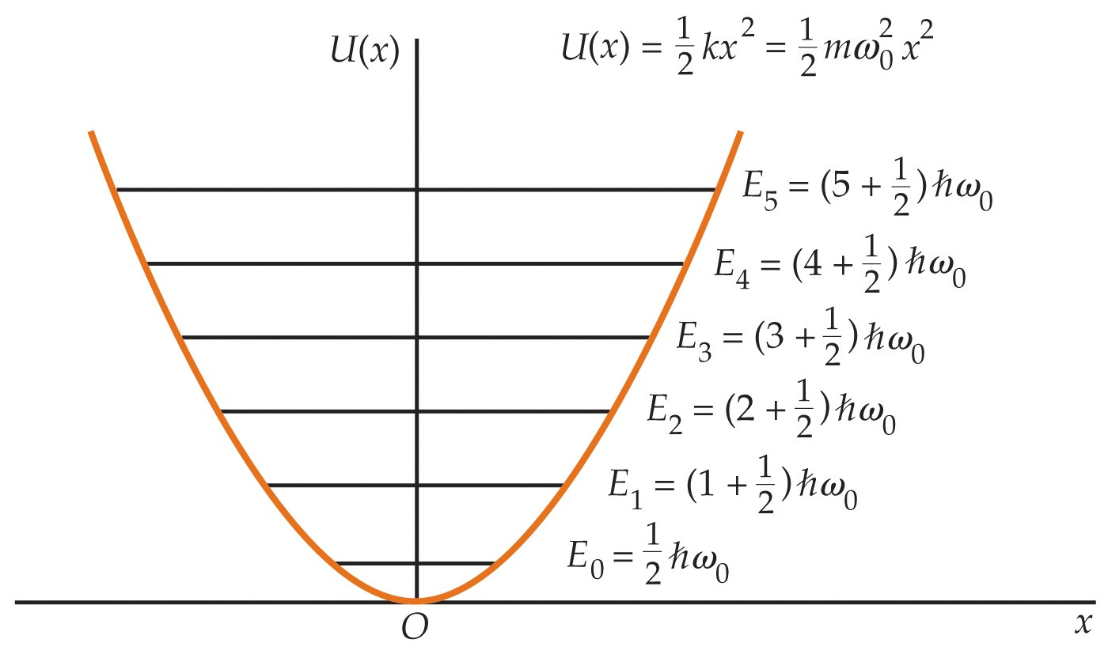

Slide 23
35-4
Reflection and Transmission of Electron Waves:
Barrier Penetration

Slide 24
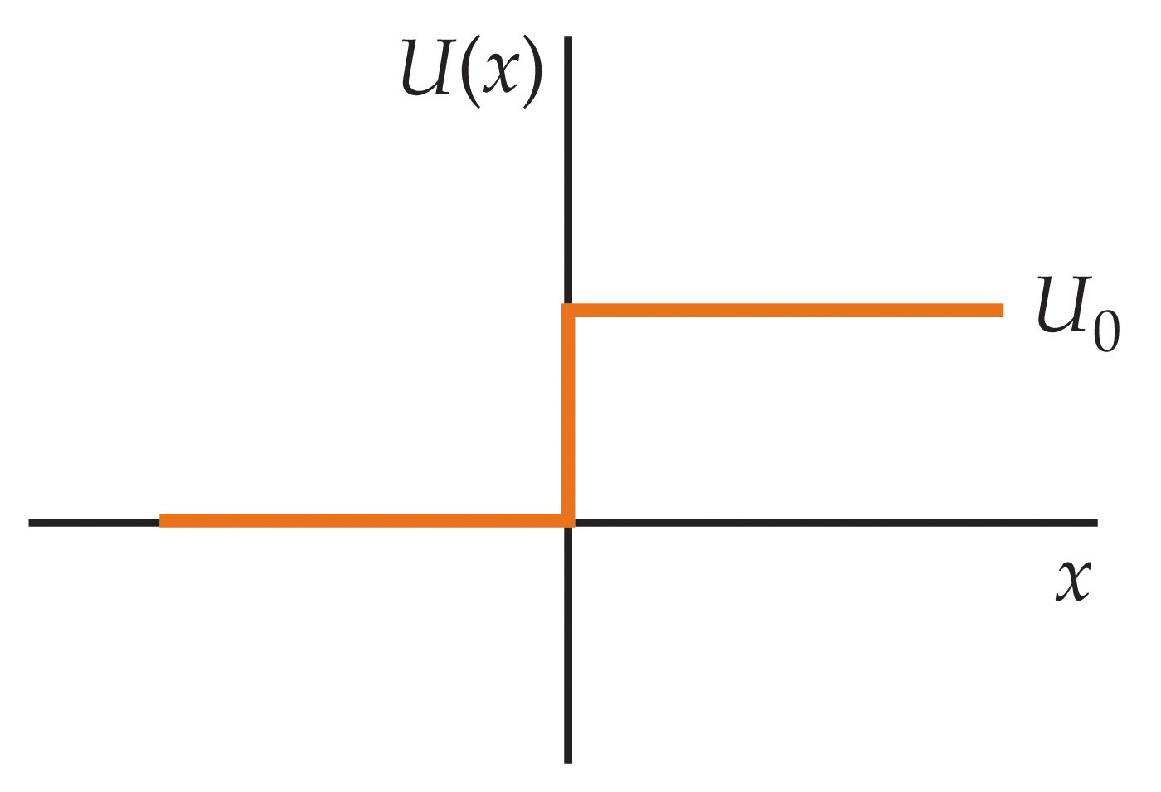

Slide 25
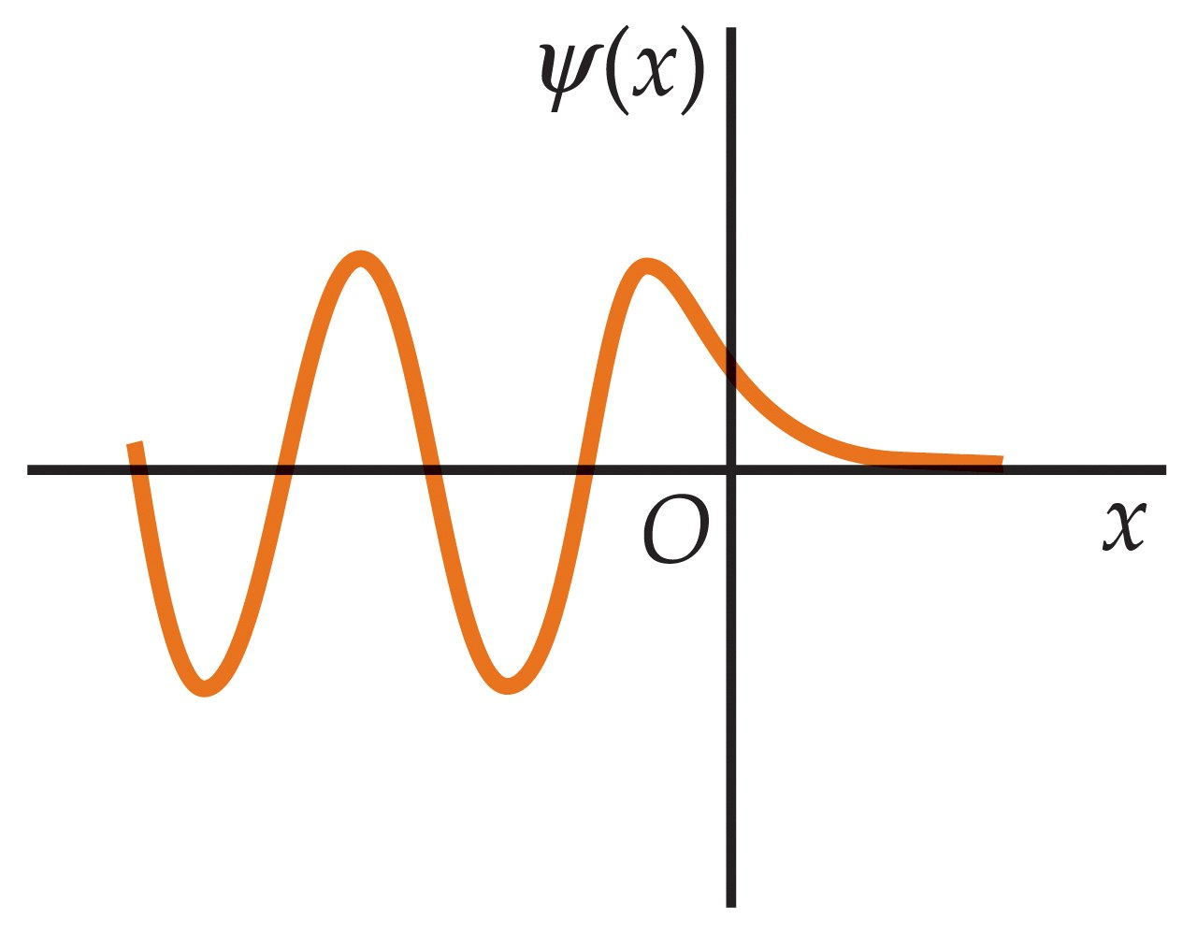

Slide 26
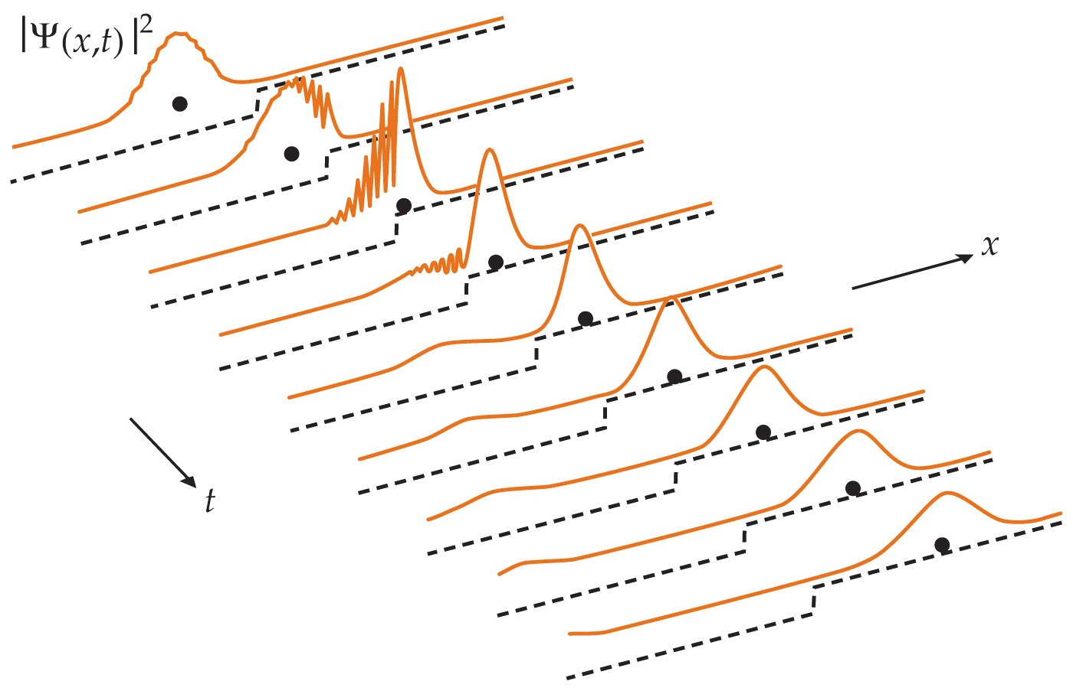

Slide 27
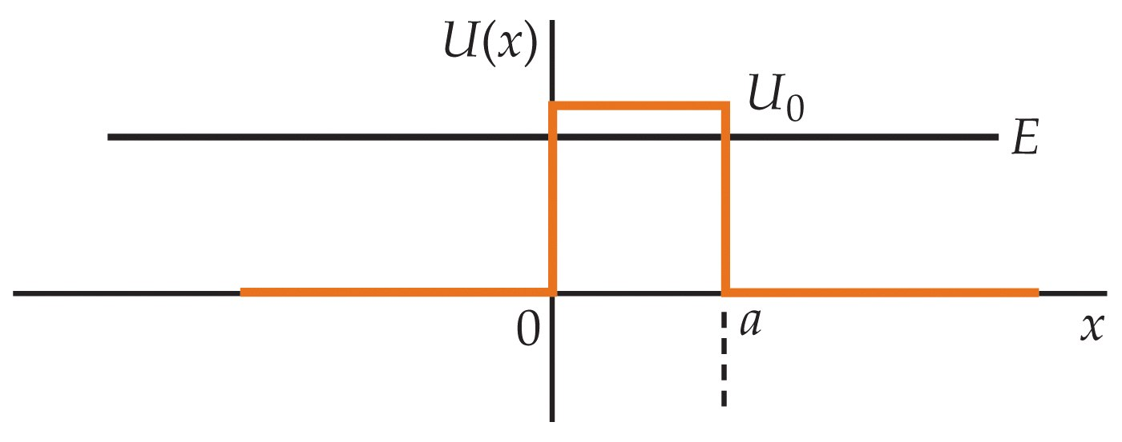

Slide 28
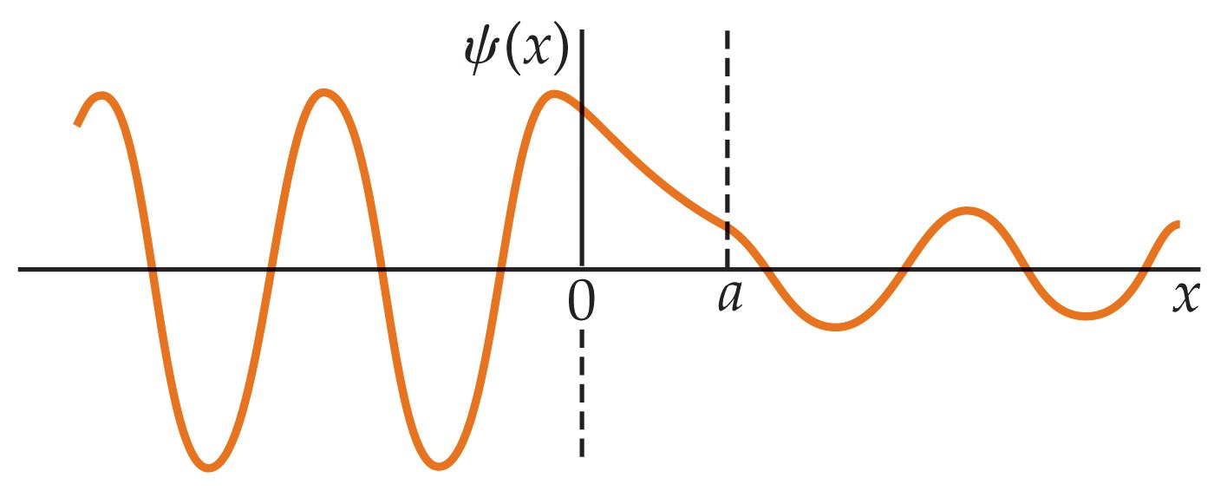

Slide 29


Slide 30
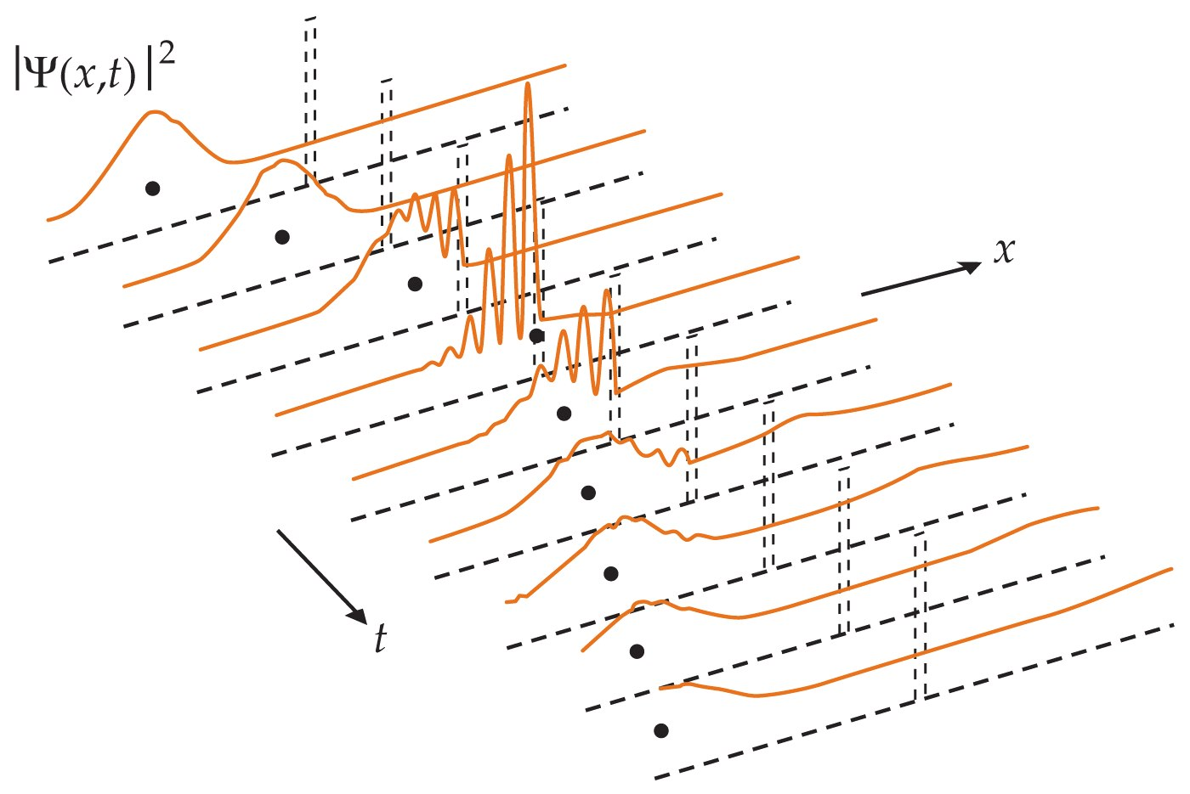

Slide 31
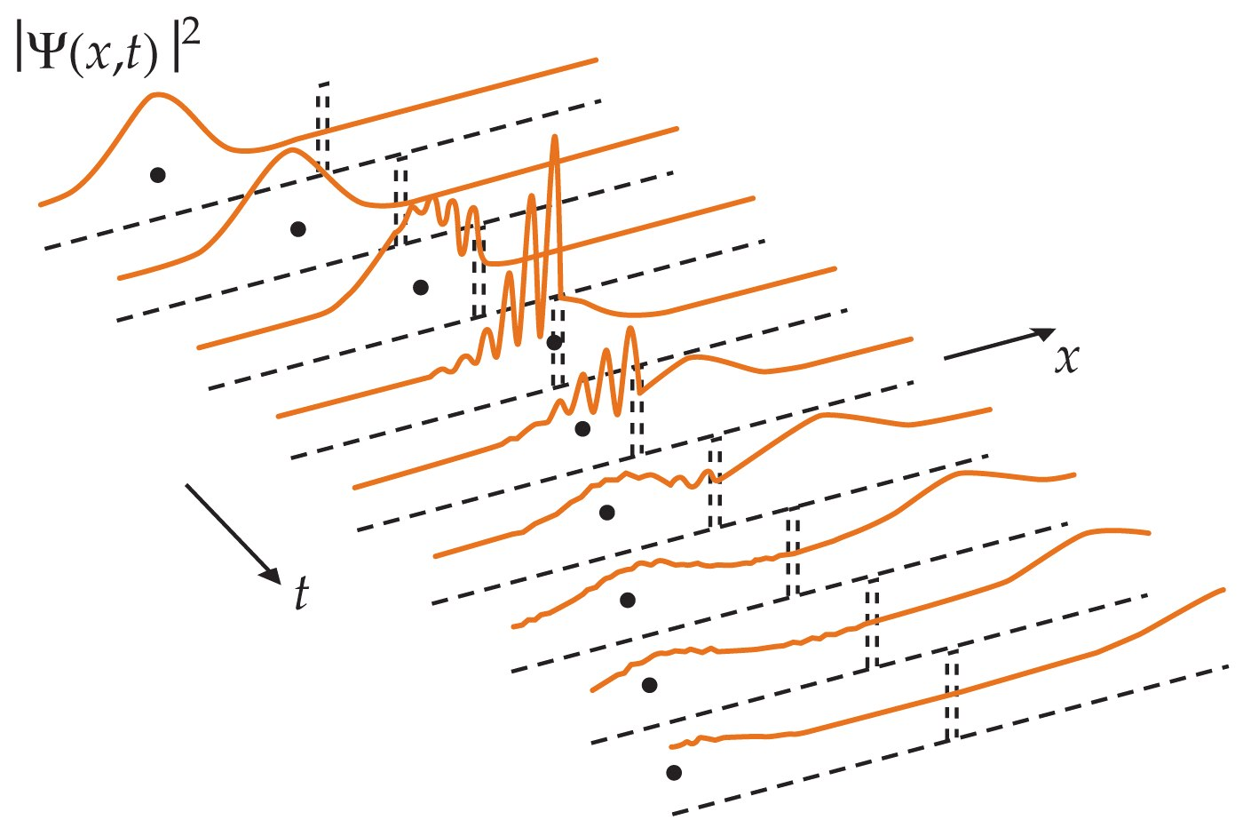

Slide 32
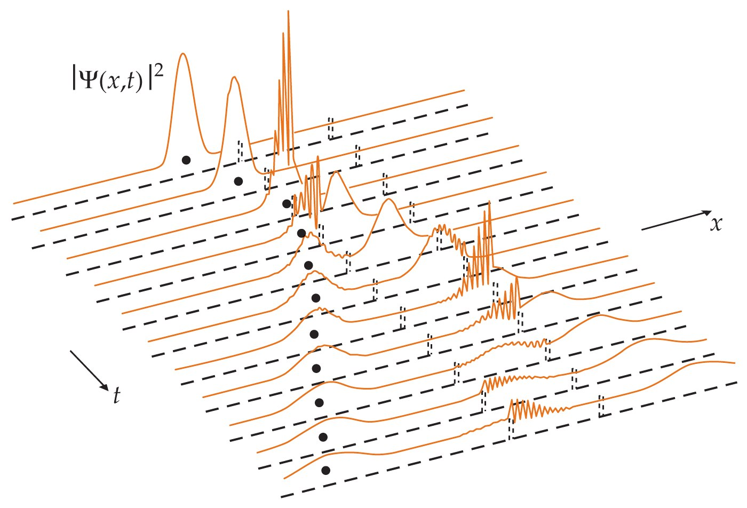

Slide 33
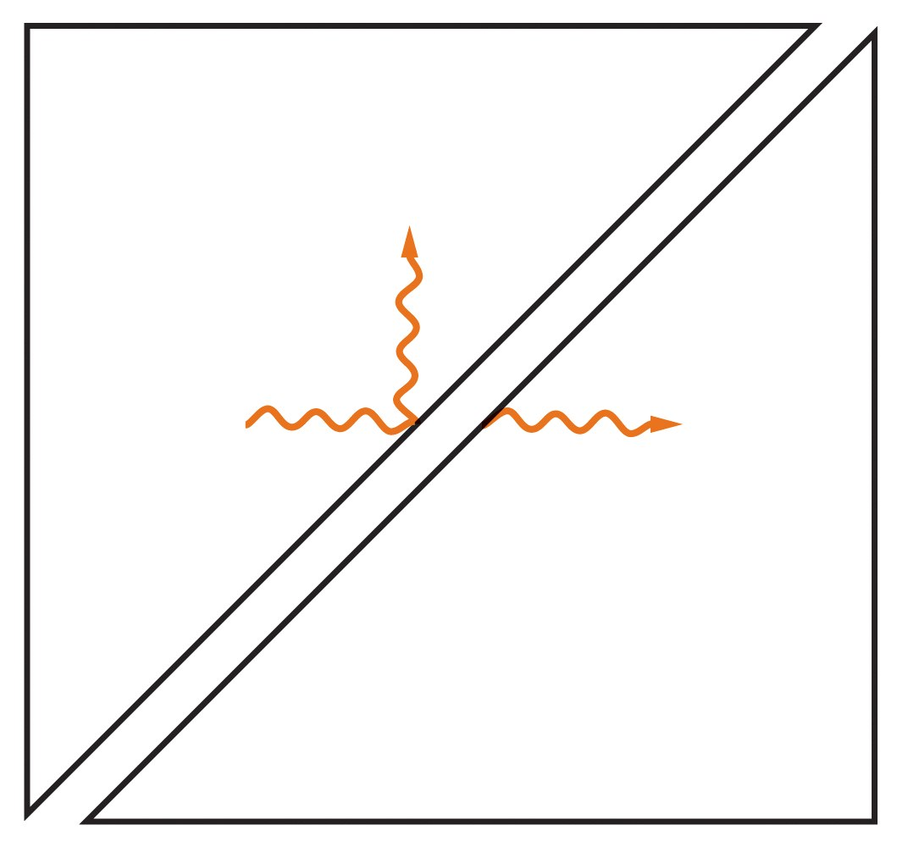

Slide 34
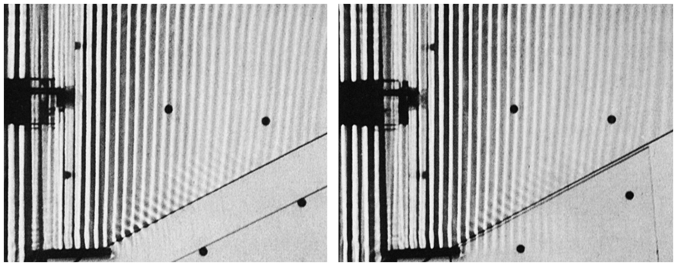

Slide 35
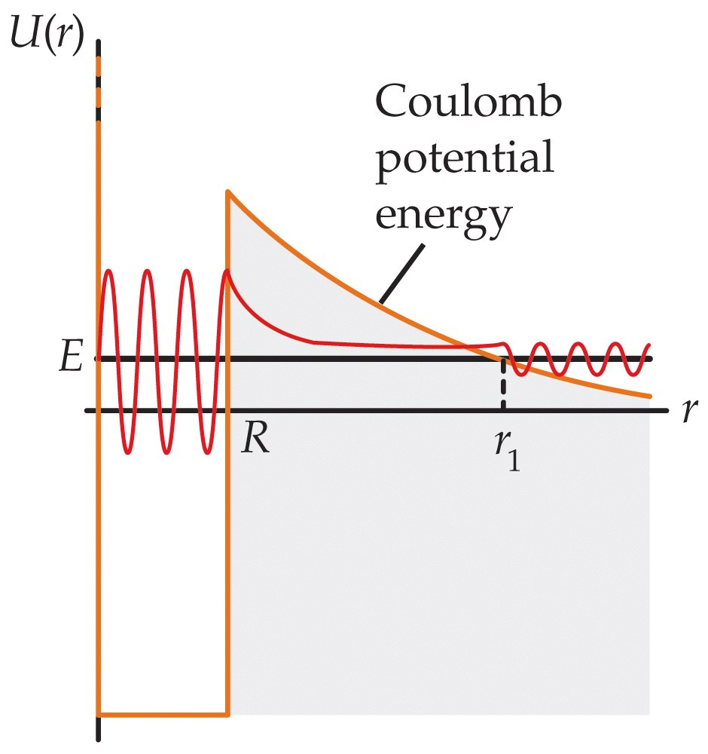

Slide 36
35-5
The Schrödinger Equation in Three Dimensions

Slide 37
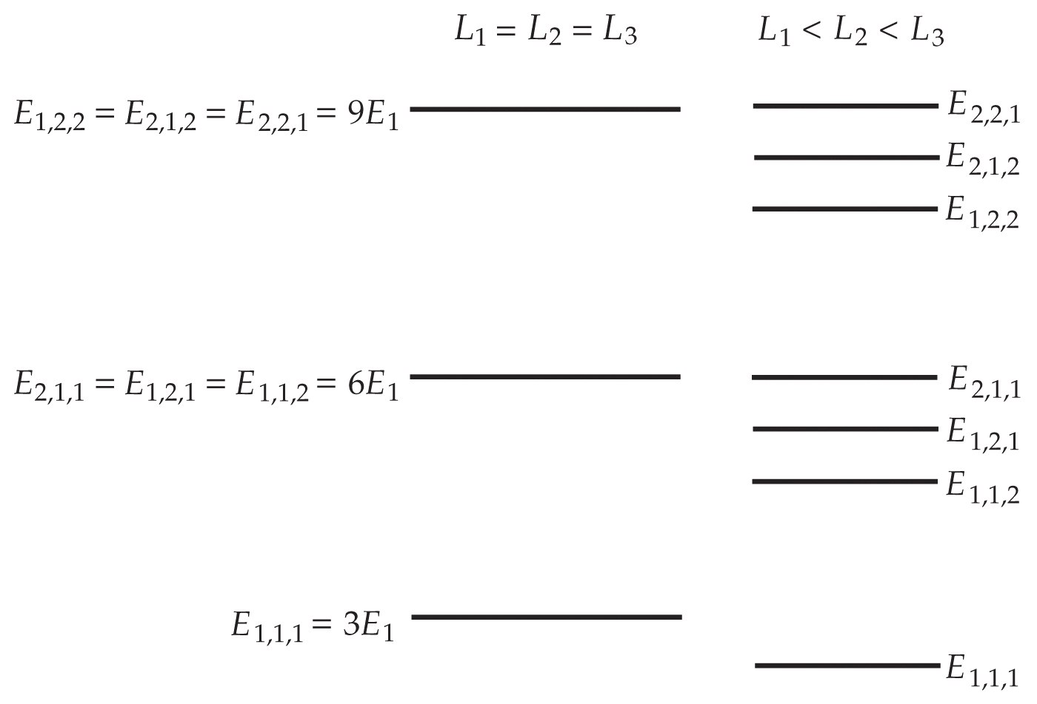

Slide 38
35-6
The Schrödinger Equation for Two Identical Particles

Slide 39
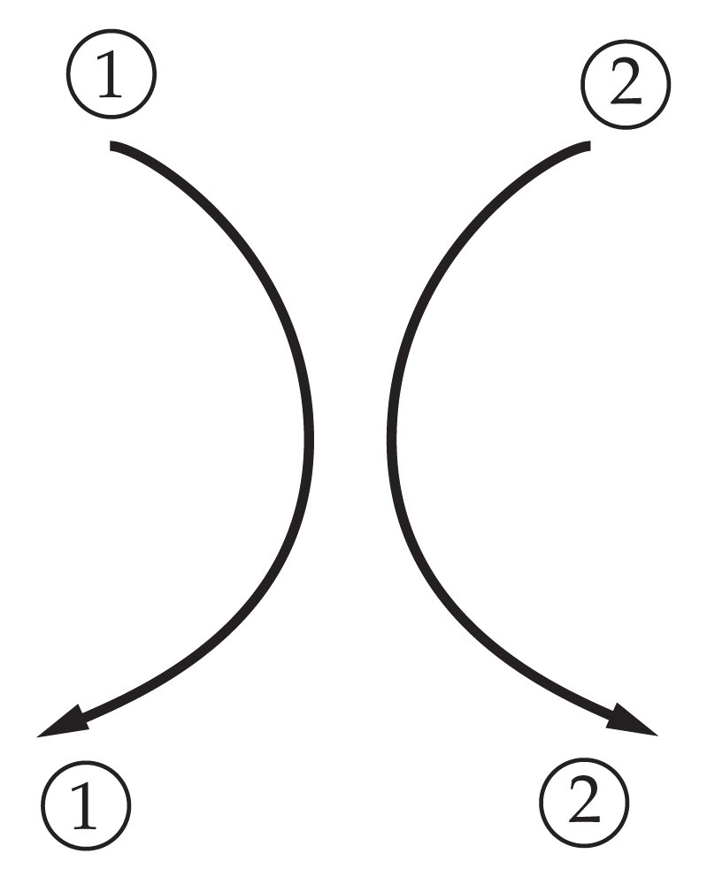

Slide 40
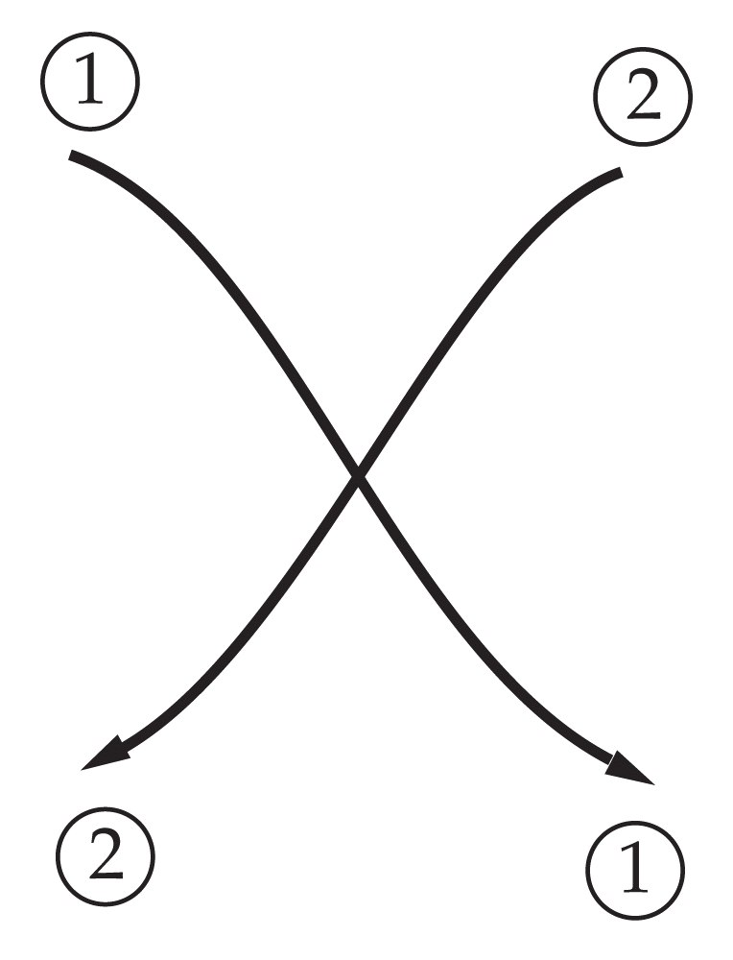

Slide 41
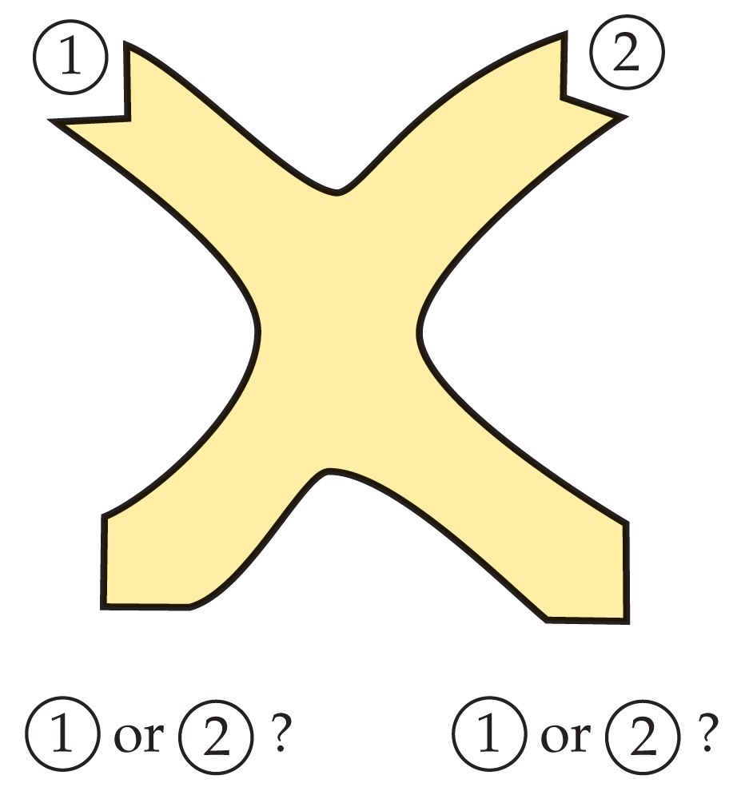

Slide 42


